Slide 1
Hepatic Arteriography and C-Arm CT-Guided Ablation of Liver Tumors (HepACAGA): A Case Report
Bipul Mainali, BS
Andrew McClellan, BS
UAB Heersink School of Medicine
Junaid Raja, MD, MSPH FACP FAAP
Venkatesh P. Krishnasamy, MD FCIRSE
UAB Division of Interventional Radiology

Slide 2
Background
Hepatocellular carcinoma (HCC) is the most common primary liver malignancy. Percutaneous thermal ablation is a cornerstone of treatment, but tumor targeting can be challenging with conventional ultrasound or non contrast CT guidance. This is particularly true for small, poorly visualized, or difficult to reach lesions.
Cone beam CT hepatic arteriography (C-arm CTHA) improves tumor conspicuity by utilizing selective intra-arterial contrast injection rather than intravenous or no contrast. This technique significantly enhances visualization of hypervascular tumors compared to conventional imaging techniques [1].
The HepACAGA technique (Hepatic Arteriography and C-arm CT-Guided Ablation) also integrates C-arm CTHA with C-arm guided needle placement, enabling the entire procedure to be performed in the angiography suite. This eliminates patient transfer between angiography and CT rooms, reducing risk of catheter displacement and logistical challenges [1].
Additional advantages of the angiography suite workflow include integrated needle guidance software for precise antenna placement, intraprocedural margin assessment with CBCT fusion, and the ability to quickly convert to transarterial therapies (Y90 or TACE) if lesions are not amenable to thermal ablation [2].

Slide 3
Clinical Presentation
76 y/o female with treatment-naïve HCV cirrhosis and history of biopsy-proven HCC. Index lesion was a 6.3 cm segment 5 HCC with right portal vein tumor thrombus treated with radioembolization resulting a radiologic complete response. PMH also significant for partial hepatectomy approximately 35 years ago due to gunshot wound. She was deemed not to be a transplant candidate due to her age and comorbidities.
MRI revealed two new LR-5 lesions in segment 3: a 2.2 cm lateral lesion and a 1.3 cm medial lesion. Liver function remained compensated (Child-Pugh A5, ALBI Score -2.51 [Grade 2]) with an AFP 12.2, albumin 3.6, bilirubin 0.4, INR 1.08, and platelets 104k. Patient was referred for evaluation of locoregional treatment options.

Slide 4
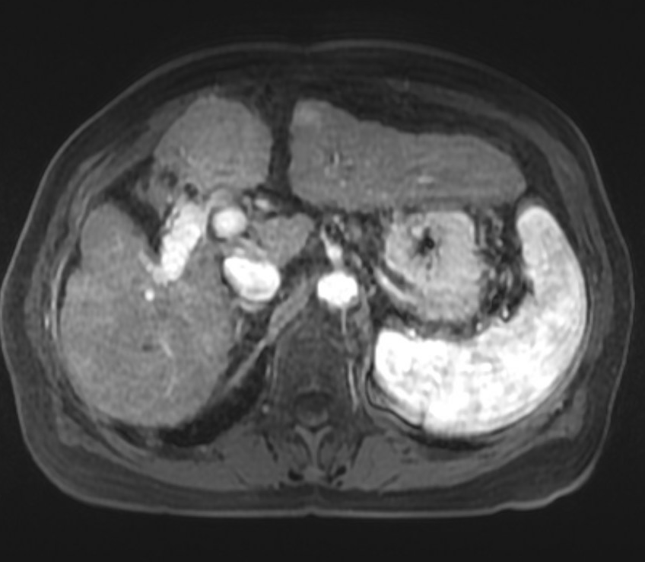
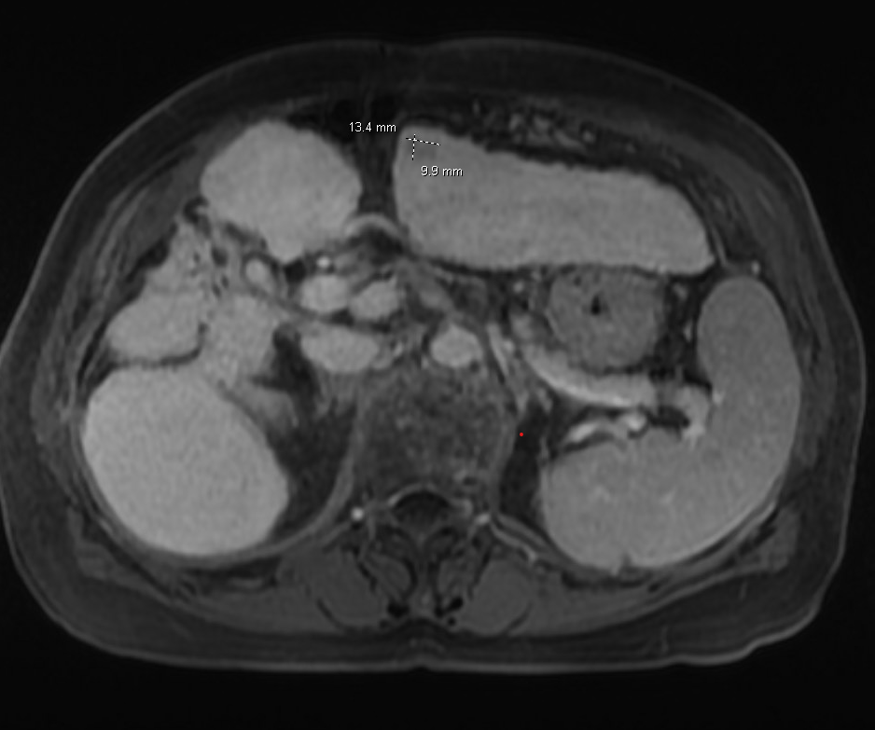
Pre Intervention Imaging
A
B
Pre-procedure MRI demonstrates the medial LR-5 lesion (purple arrows) in segment 3 of the left hepatic lobe measuring 1.3 cm adjacent to the fissure for ligamentum teres, demonstrating arterial enhancement (A) with venous phase washout (B) consistent with HCC.

Slide 5
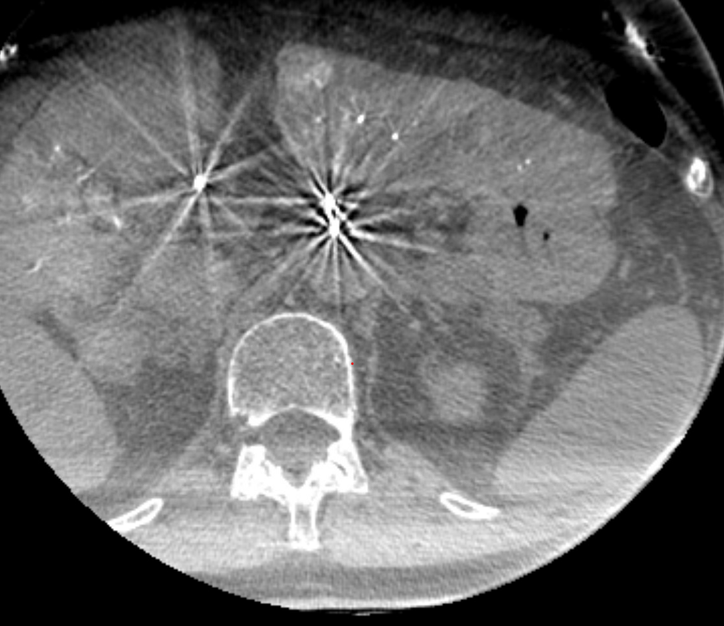
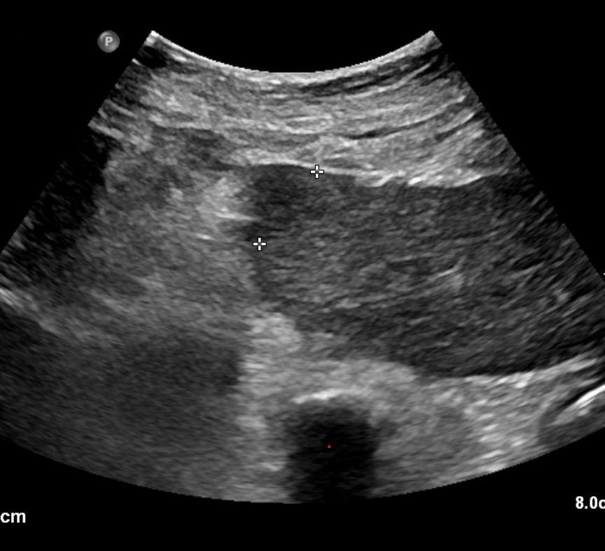
Intraprocedure Imaging: C-arm CT Hepatic Arteriography
A
B
C-arm CTHA via selective left hepatic artery catheterization delineates the hypervascular medial segment 3 tumor (purple arrow) with superior conspicuity (A). Sonographic evaluation also demonstrated the hypoechoic tumor (B).

Slide 6
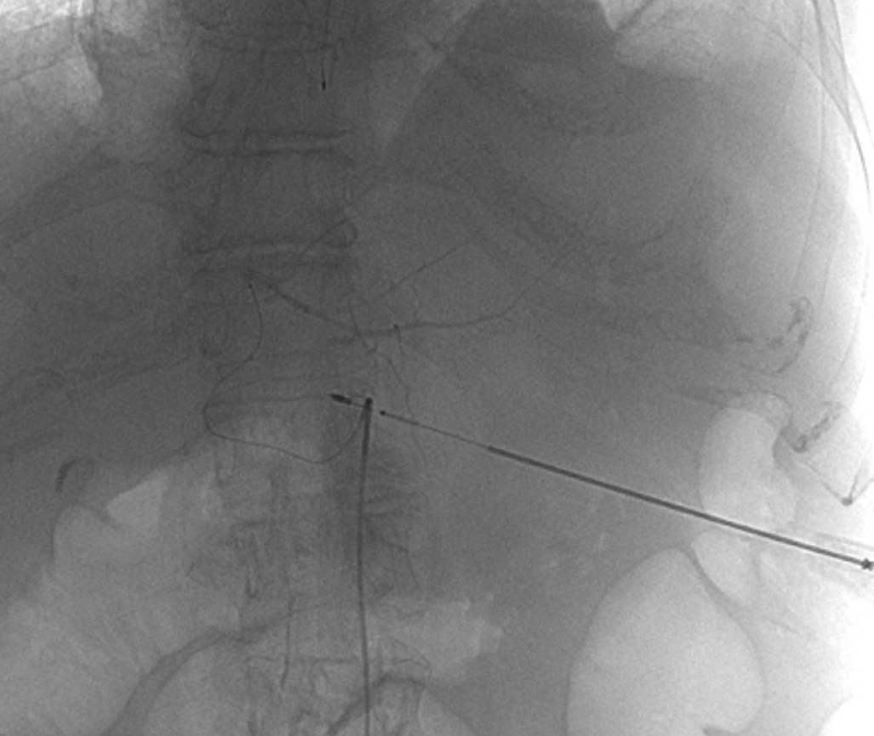
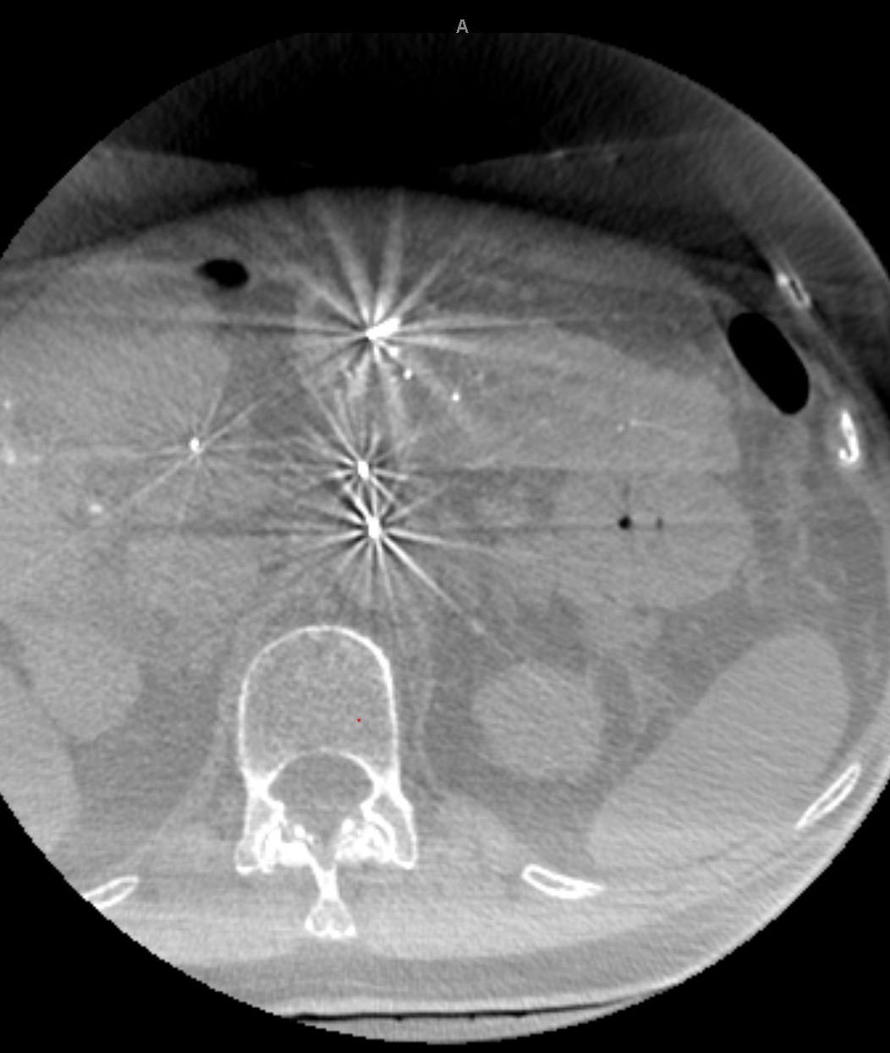
Procedure: HepACAGA Technique
The HepACAGA procedure was performed entirely in the angiography suite under general anesthesia [1]. Right common femoral artery access was obtained. After catheterization of the celiac axis, a microcatheter was advanced into the left hepatic artery for performance of the C-arm CTHA.
Using contrast-enhanced CBCT (A) and ultrasound guidance, a Varian microwave antenna was placed through the targeted lesion. This was confirmed by repeat contrast enhanced CBCT (B). NS hydrodissection was performed for protection of the anterior abdominal wall and colon adjacent to the medial lesion.
A
B

Slide 7
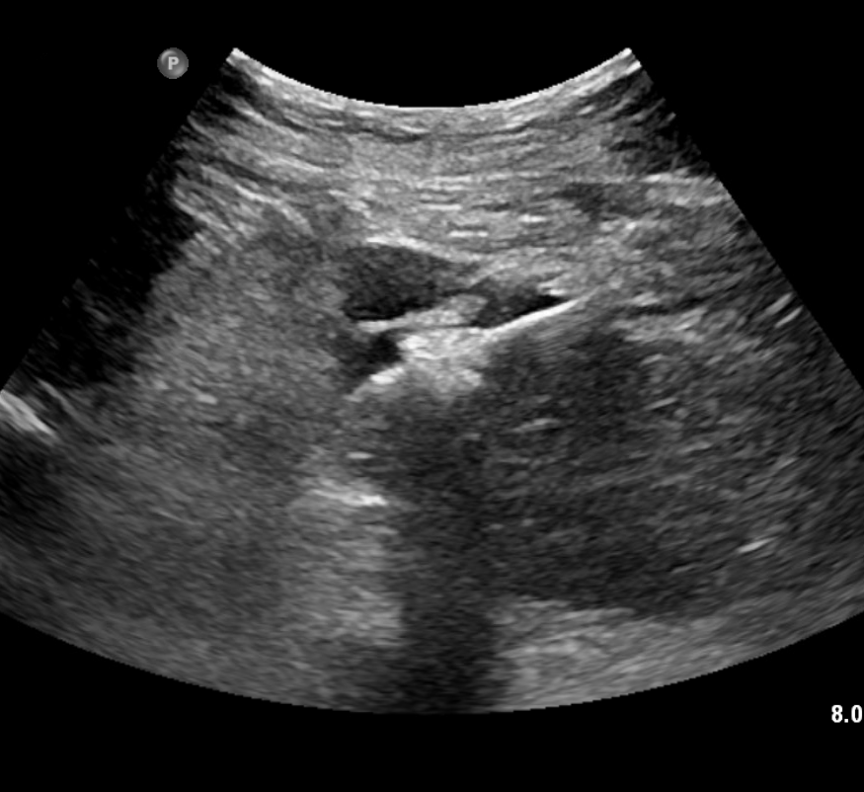
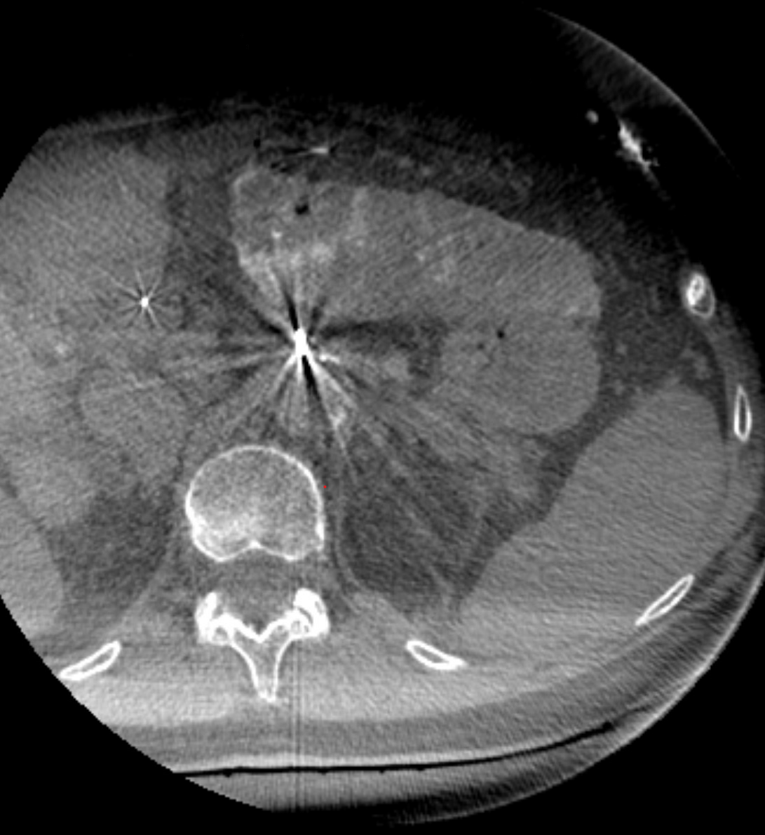
Procedure: Ablation and Margin Assessment
A
B
Initial ablation was performed at 90 W for 2.5 minutes with real-time ultrasound visualization monitoring of microbubble formation (purple arrow) (A). The antenna was repositioned more inferiorly and a second ablation at 90 W for 2.5 minutes was performed. Completion contrast-enhanced cone beam CT demonstrated adequate ablation zone coverage (purple circle) with appropriate margins of the target lesion (B).
Post-ablation cone beam CT
The lateral segment 3 lesion was poorly visualized and in close proximity to the stomach posteriorly, precluding hydrodissection and safe thermal ablation. Per the HepACAGA workflow advantage, the intra-arterial catheter was already in position which enabled immediate Y90 mapping for planned future Y90 radiation segmentectomy without requiring a separate procedure.

Slide 8
Technical Details
HepACAGA Procedure Details
Access: Right common femoral artery, 6 Fr sheath
Catheter: Diagnostic 5F C2 catheter celiac axis, 2F Truselect microcatheter left hepatic artery
Guidance: C-arm CTHA + ultrasound
Ablation device: Varian IntelliBlate microwave system
Ablation protocol: 90 W × 5 minutes × 2 applications with repositioning
Hydrodissection: NS for anterior abdominal wall and colon protection
Margin assessment: Pre- and post-ablation contrast-enhanced cone beam CT
Closure: Perclose closure of right CFA
Contrast volume: 104 mL Visipaque 270
Fluoroscopy time: 11.3 minutes
EBL: <50 mL
Complications: None
Post-ablation cone beam CT

Slide 9
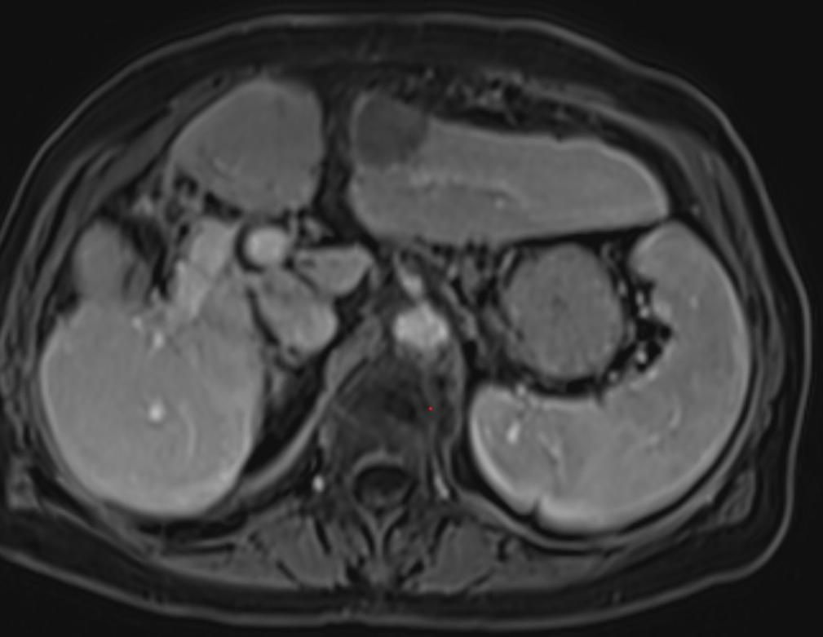
Follow-up
A
At 1-month follow-up, patient reported feeling well with no acute complaints. MRI demonstrated complete response of the medial segment 3 lesion (A). The lateral lesion was subsequently treated with Y90 radiation segmentectomy in a separate session.

Slide 10
Discussion:
The HepACAGA technique demonstrated 93% technical success (26/28 tumors) and 0% local tumor recurrence at median 16-month follow-up in the original series by Smits et al. Median antenna placement deviation was only 1 mm, reflecting the precision afforded by integrated C-arm navigation software [1].
A comparative analysis of HepACAGA versus conventional US/CT-guided ablation (68 vs 53 patients) demonstrated significantly improved local tumor recurrence-free survival with HepACAGA (p = 0.015). Local tumor recurrence rates were 5% with HepACAGA versus 26% with conventional ablation (p < 0.001). Complication rates were also lower: 4% versus 15% (p = 0.041) [3].
Recent data from Wijnen et al. suggests that HepACAGA can effectively treat tumors 3-5 cm in diameter without compromising local tumor progression-free survival, potentially expanding the traditional size criteria for thermal ablation. Complication rates remained low at 4-13% depending on tumor size [4].

Slide 11
Discussion
This case illustrates several key advantages of the HepACAGA technique:
1. Superior tumor visualization: C-arm CTHA via selective intra-arterial contrast injection provided enhanced conspicuity of hypervascular HCC lesions compared to conventional imaging.
2. Precise antenna placement: Cone beam CT guidance enabled accurate targeting with real-time confirmation.
3. Intraprocedural margin assessment: Pre- and post-ablation cone beam CT allowed confirmation of adequate ablation zone coverage.
4. Workflow flexibility: When the lateral lesion was identified as unsuitable for thermal ablation due to lesion location and gastric proximity, the catheter already in position enabled immediate transition to mapping for Y90 radiation segmentectomy, avoiding treatment delay [2].
The angiography suite-based workflow represents an evolving paradigm in interventional oncology, maximizing treatment precision while maintaining flexibility for multimodal therapy.

Slide 12
References
1. Smits MLJ, Bruijnen RCG, Tetteroo P, et al. Hepatic Arteriography and C-Arm CT-Guided Ablation (HepACAGA) to Improve Tumor Visualization, Navigation and Margin Confirmation in Percutaneous Liver Tumor Ablation. Cardiovasc Intervent Radiol. 2023;46(10):1365-1374. doi:10.1007/s00270-023-03545-4
2. Wijnen N, Ramdhani K, Bruijnen RCG, et al. The Added Benefits of Performing Liver Tumor Ablation in the Angiography Suite: A Pictorial Essay of Combining C-Arm CT Guidance with Hepatic Arteriography for Liver Tumor Ablation. Cancers (Basel). 2025;17(14):2330. doi:10.3390/cancers17142330
3. Wijnen N, Bruijnen RCG, Vonken EPA, et al. Conventional versus Hepatic Arteriography and C-Arm CT-Guided Ablation of Liver Tumors (HepACAGA): A Comparative Analysis. Cancers (Basel). 2024;16(10):1925. doi:10.3390/cancers16101925
4. Wijnen N, Ruijs E, Bruijnen RCG, et al. Impact of Tumor Size on Outcomes of Hepatic Arteriography and C-Arm CT-Guided Ablation (HepACAGA): >3 cm Is No Absolute Contraindication. Cardiovasc Intervent Radiol. 2026;49(1):59-69. doi:10.1007/s00270-025-04167-8

